Slide 1
MCB 545
Week 2
Monday: The Human Genome; Intro to Linux / Biocluster
Wednesday: DNA-RNA binding proteins, Genomic Data Resources

Slide 2
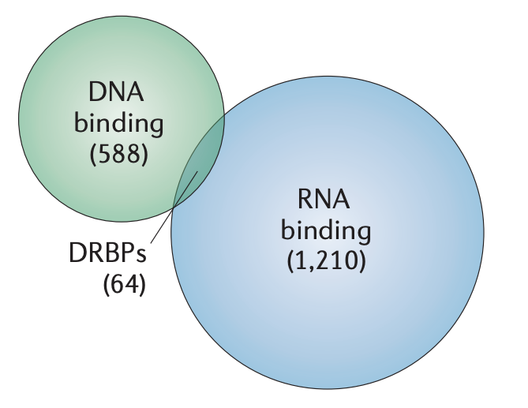
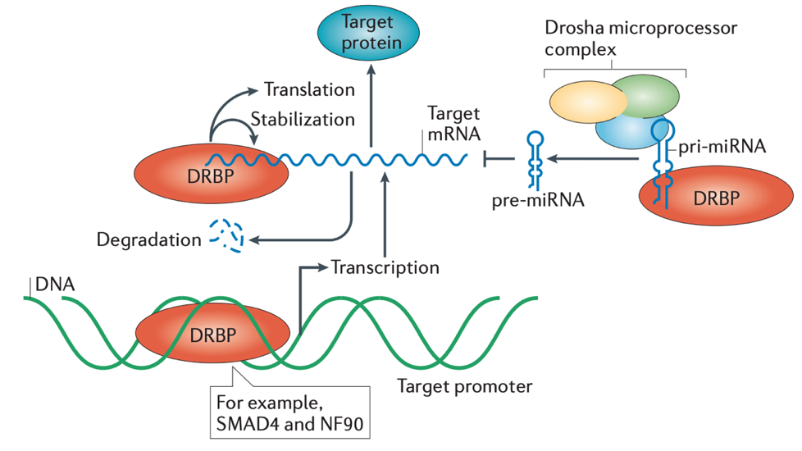
Our goal: DNA-RNA binding protein biology
Which genes are sensitive to DRBP silencing?
Are they directly targeted at the DNA and/or RNA level?
How are DRBPs themselves regulated at the gene level?
HNRNPK
HNRNPL
HNRNPUL1
PTBP1
PCBP1
PCBP2
SRSF1
SRSF9
SRSF7
SFPQ
PRPF4
U2AF2
SAFB
SAFB2
MATR3
POLR2G
GT2F1
HLTF
BLAF1
NKRF
RBM15
FUS
EWSR1
TAF15
ZC3H11A
ZC3H8
RBM22 (ZC3H16)
ZNF622
ZNF800
RBM22
NONO
TARDBP
LARP7
KHSRP (FUBP2)
FUBP3
HNRNPK
Human genes / proteins
Hudson & Ortlund, 2014

Slide 3
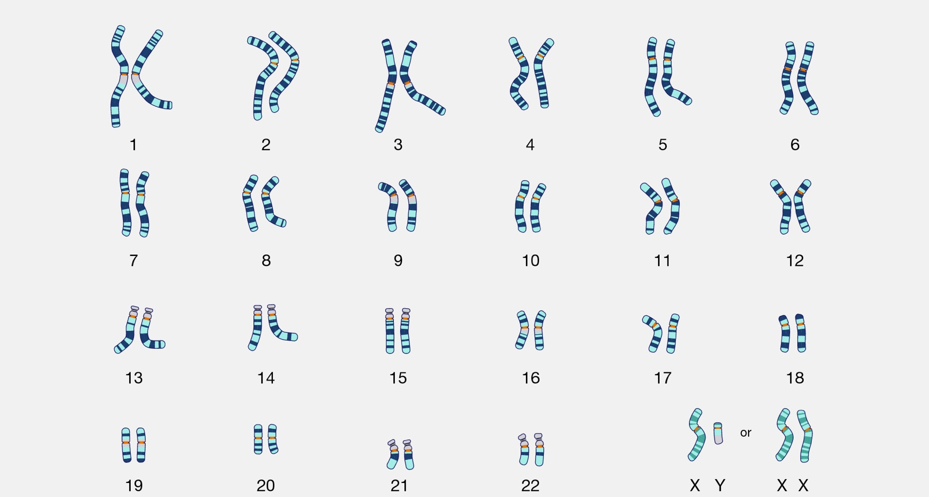
The human (diploid) genome
karyotype (chromosome count)
24 distinct chromosomes
autosomes 1-22
sex chromosomes X, Y
cytogenetics = identification of extra, missing, or chromosomal rearrangements
NHGRI (genome.gov)

Slide 4
Where do we begin? We need a reference
What is the sequence and location of genes encoding our DRBPs?
A reference is needed to identify gene / protein structure
What is the sequence and location of genes potentially sensitive to disruption of our DRBPs?
A reference is needed for RNA (expression) read alignment
What is the sequence and location of genes or ncRNAs directly targeted by our DNA-RNA binding proteins?
A reference is needed for ChIP (DNA-binding) and eCLIP (RNA- binding) read alignment

Slide 5


What is the IDEAL reference?
“The Human Genome” ?
Cell line (e.g. K562)
genome?
something else?

Slide 6
Perfect or imperfect, we need a reference
1. The quick brown fax jumped over the lazy doge.
2. The quick _ fox jumps over the lazy doge.
3. The quick brown fox jumped over the lazy brown dog.
Ref. The quick brown fox jumped over the lazy doge.
Genome analyses need a common reference coordinate system
A synthetic hybrid reference facilitates identification of what is divergent from population
Derek Caetano-Anolles
https://gatk.broadinstitute.org/hc/en-us/articles/360035891071

Slide 7
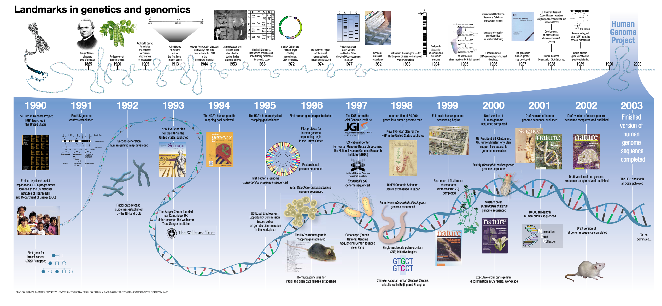
The Human Genome Project
1990 – 2003: The Human Genome Project
NHGRI (genome.gov)

Slide 8
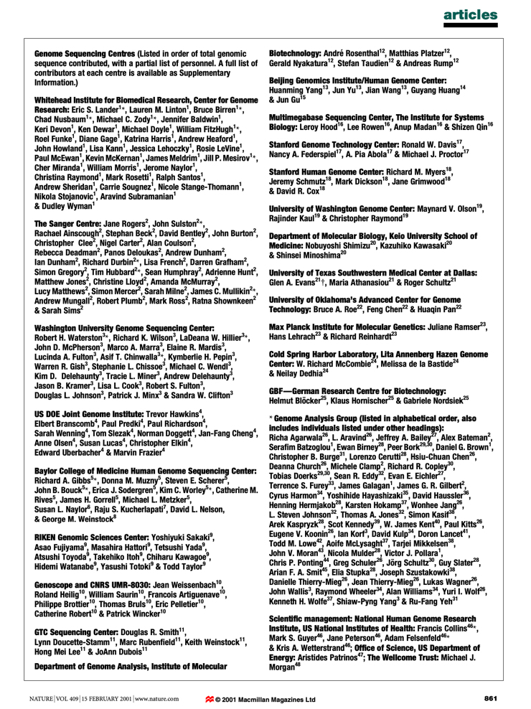
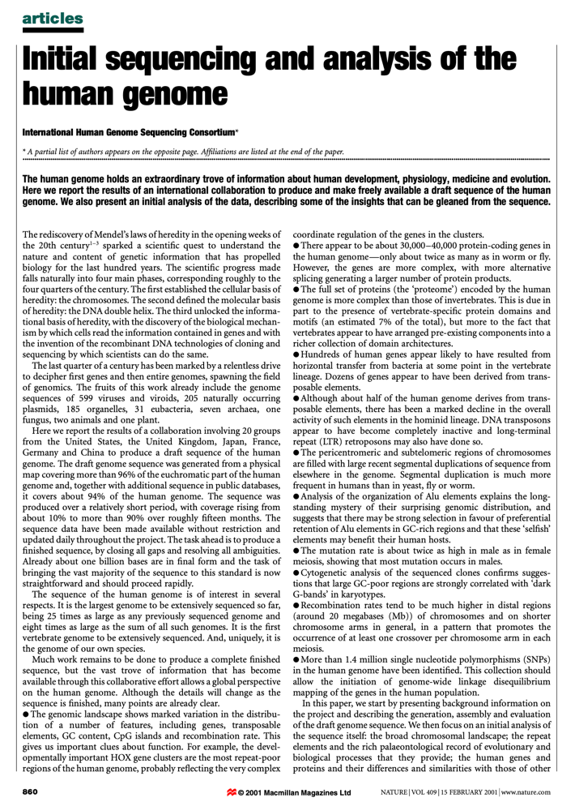
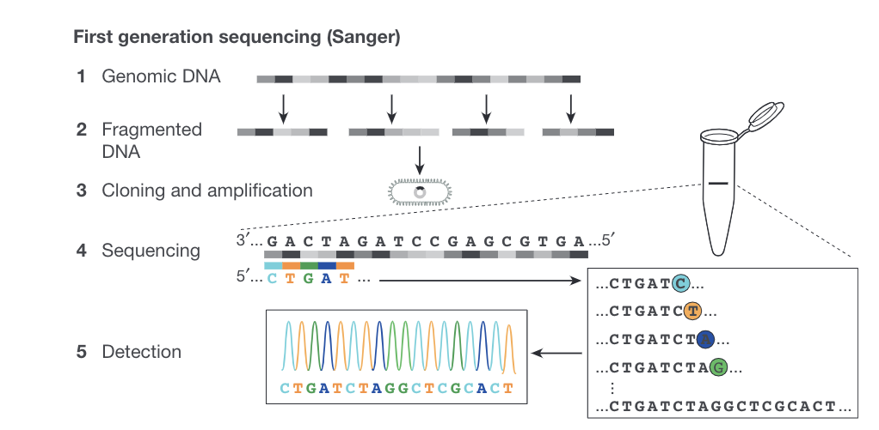
Generating the draft genome sequence
Hierarchical shotgun sanger sequencing
Shendure et al., Nature 2017
International Human Genome Sequencing Consortium, Nature, 2001

Slide 9
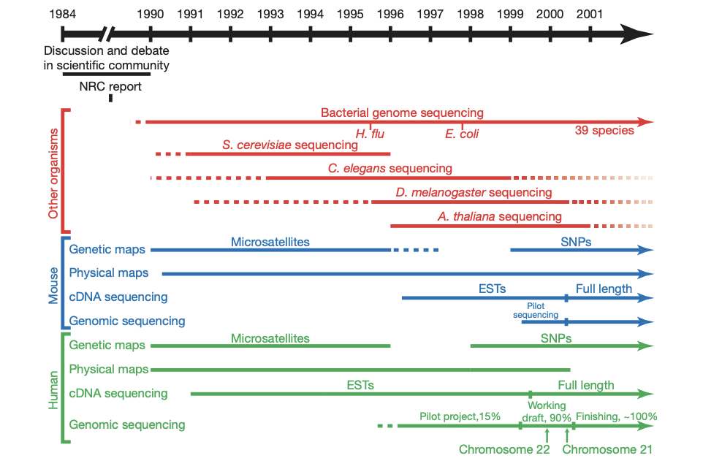
Generating the draft genome sequence
International Human Genome Sequencing Consortium, Nature, 2001

Slide 10
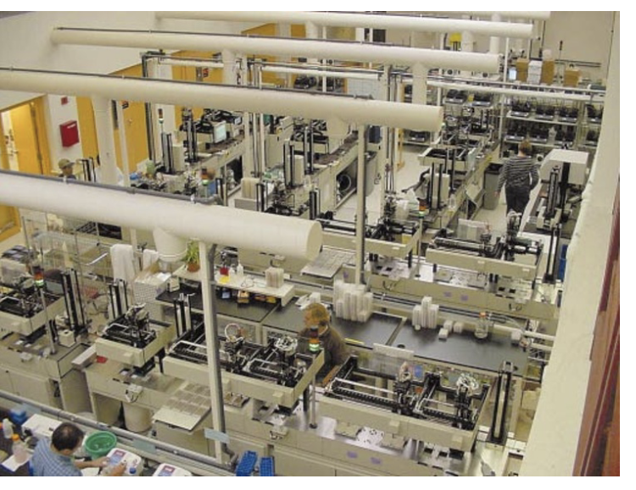
Generating the draft genome sequence
Technology development for
large-scale sequencing
1986 – ABI 370
1995 – ABI 377
1998 – ABI 3700
Engineering
Throughput
Automation/
Industrialization
Computation
International Human Genome Sequencing Consortium, Nature, 2001

Slide 11
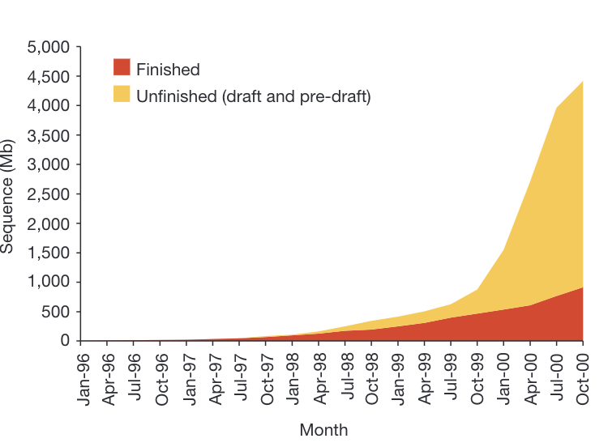
Generating the draft genome sequence
Public data sharing (GenBank)
International Human Genome Sequencing Consortium, Nature, 2001

Slide 12
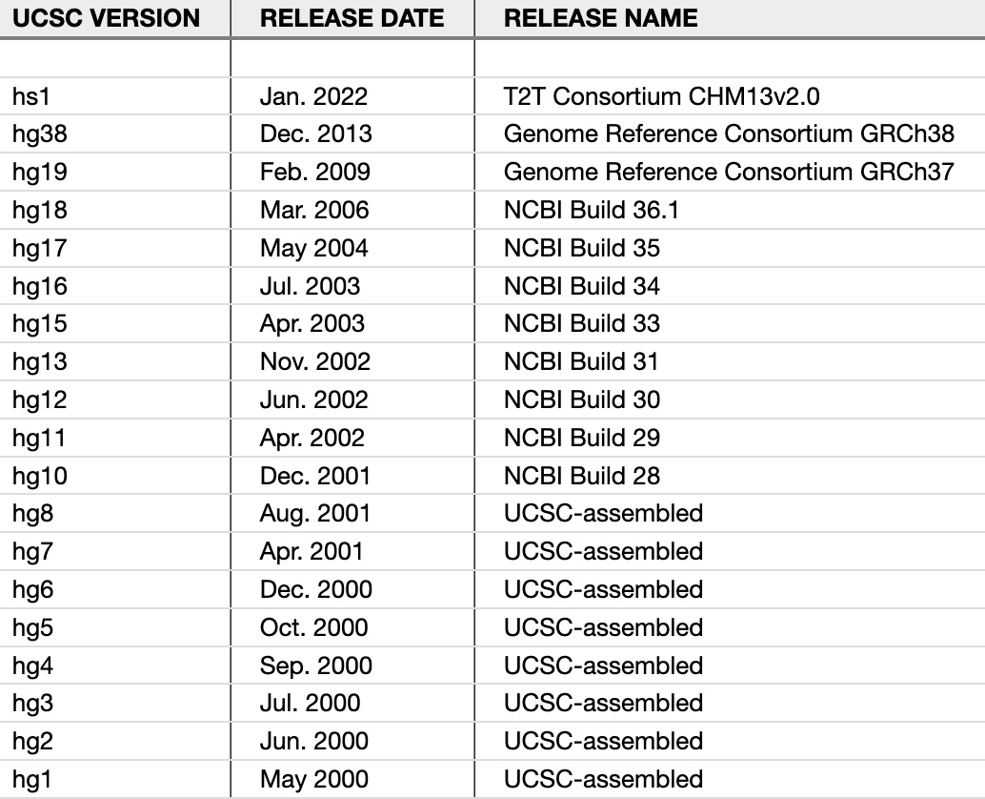
The human (reference) genome: version 1 (hg1)
Human Genome Project (HGP)
single consensus haplotype representation of each chromosome
collapsed sequences from > 50 individuals
~10% euchromatic genome missing
~ 150,000 gaps, unknown orientation/order in many regions
https://genome.ucsc.edu/FAQ/FAQreleases.html

Slide 13
The human (reference) genome: NCBI Build 35
Continual improvement
only 341 gaps (largely
reflecting heterochromatin)
resolution of local order and sequence orientation
significantly greater continuity (38.5 Mb vs. 81 Kb N50 contig)
IHGSC, Nature, 2004
https://genome.ucsc.edu/FAQ/FAQreleases.html

Slide 14
The human (reference) genome: GRCh37 (hg19)
Genome Reference Consortium (GRC) proposed new assembly model: “alternative seq. paths”
Additional (alternative) scaffold sequences with representations for regions with excess diversity
However, allelic duplication via alternative loci is problematic for repeat calculations and related analyses
Church et al., Genome Biol. 2015
https://genome.ucsc.edu/FAQ/FAQreleases.html

Slide 15
The human (reference) genome: GRCh38 (hg38)
GRCh38 corrects erroneous sequences and misassembled regions in GRCh37, relying on data from other genome sequencing projects (e.g. 1KGP)
signif. addition of ALT contigs
EBV (Epstein-Barr Virus) and decoy contigs as read-mapping “sinks”
centromere & mitochondrial
genome improvements
https://genome.ucsc.edu/FAQ/FAQreleases.html

Slide 16
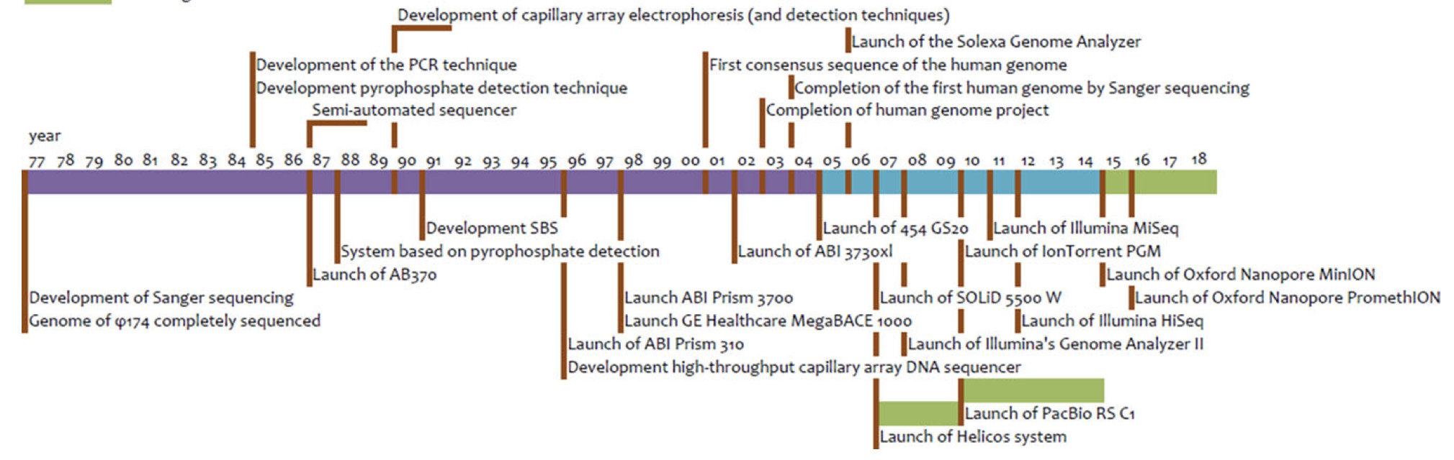

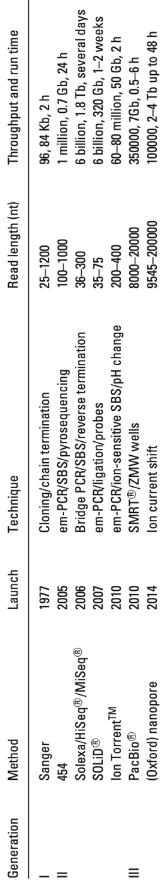
1st (Sanger) → 2nd (next) Gen → 3rd Gen Sequencing

Slide 17
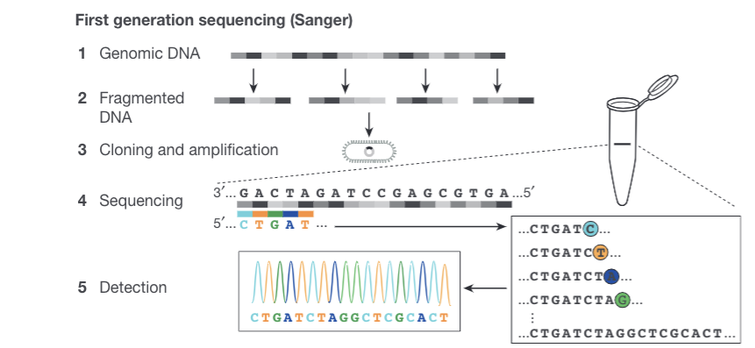
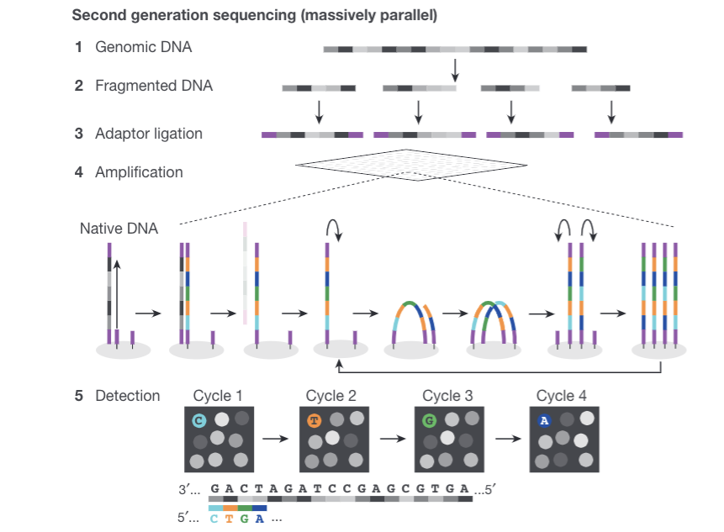
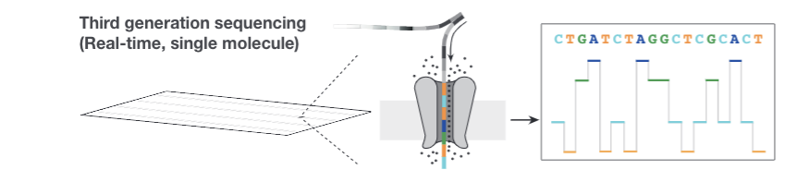
Sanger → 2nd (next) Gen → 3rd Gen Sequencing
Shendure et al., Nature 2017

Slide 18
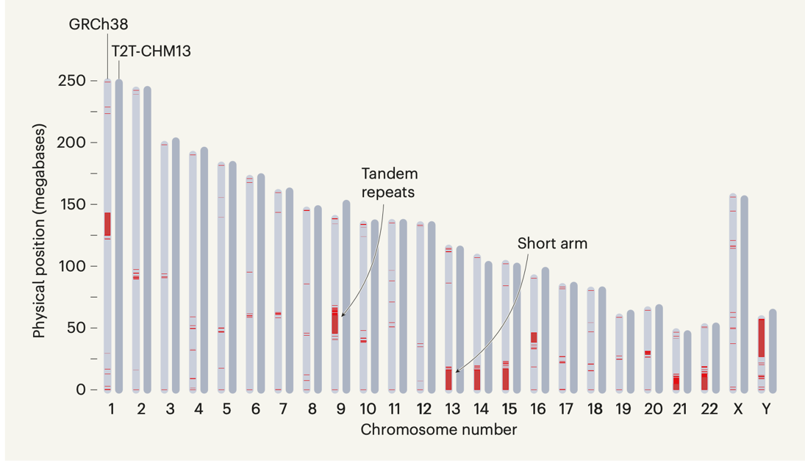
The human (reference) genome: T2T (CHM13)
Gapless telomere-to-telomere assembly of human genome
+ 238 Mbp sequence
3.6% more telomere repeats
254% more tandem repeats
Lovell & Grimwood, Nature, 2022
https://genome.ucsc.edu/FAQ/FAQreleases.html

Slide 19
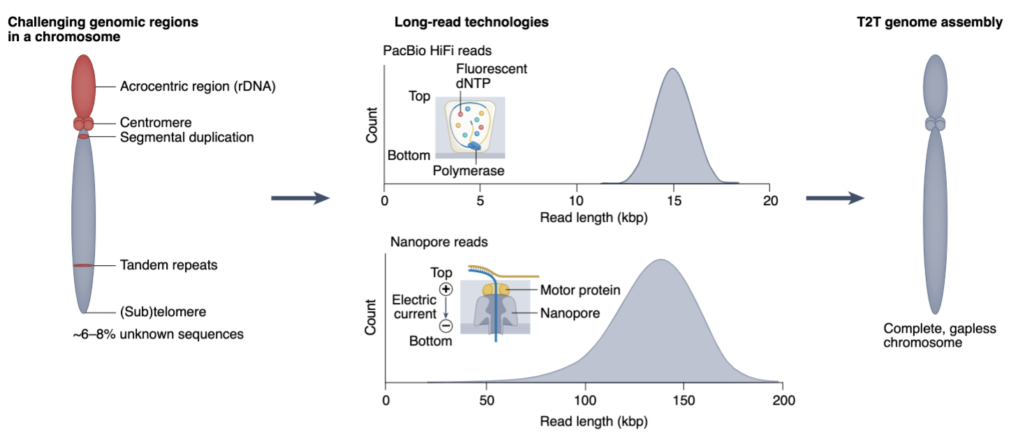
The human (reference) genome: T2T (CHM13)
Mao & Zhang, Nature Methods, 2022

Slide 20
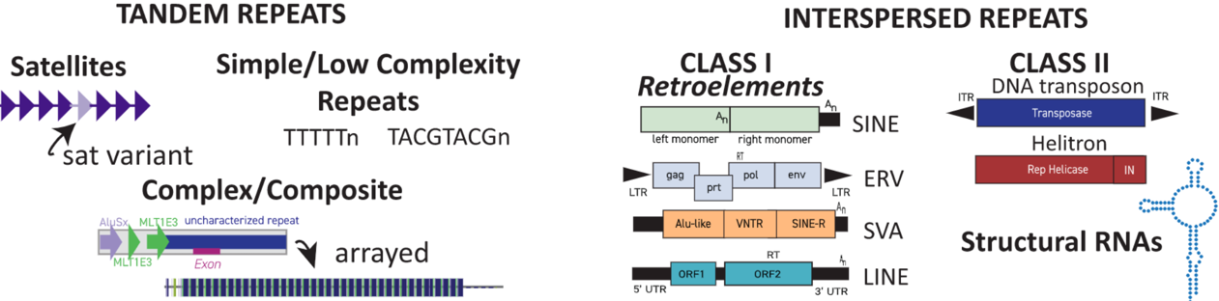
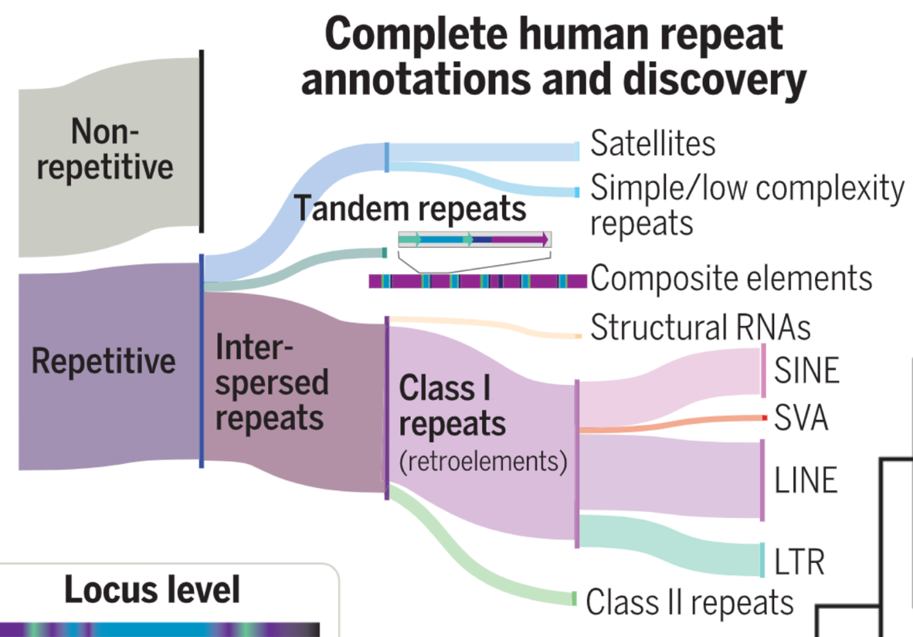
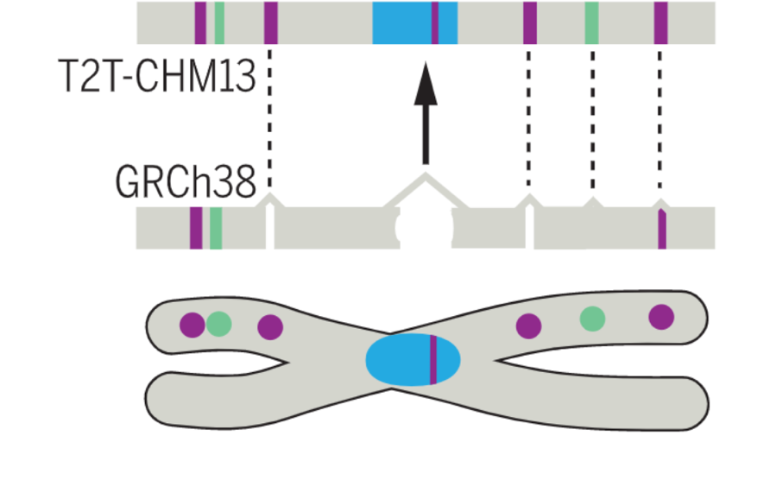
The human (reference) genome: T2T (CHM13)
Repeats, Repeats, Repeats
3.1 Mb tandem repeat X centromere
Hoyt et al., Science, 2022

Slide 21
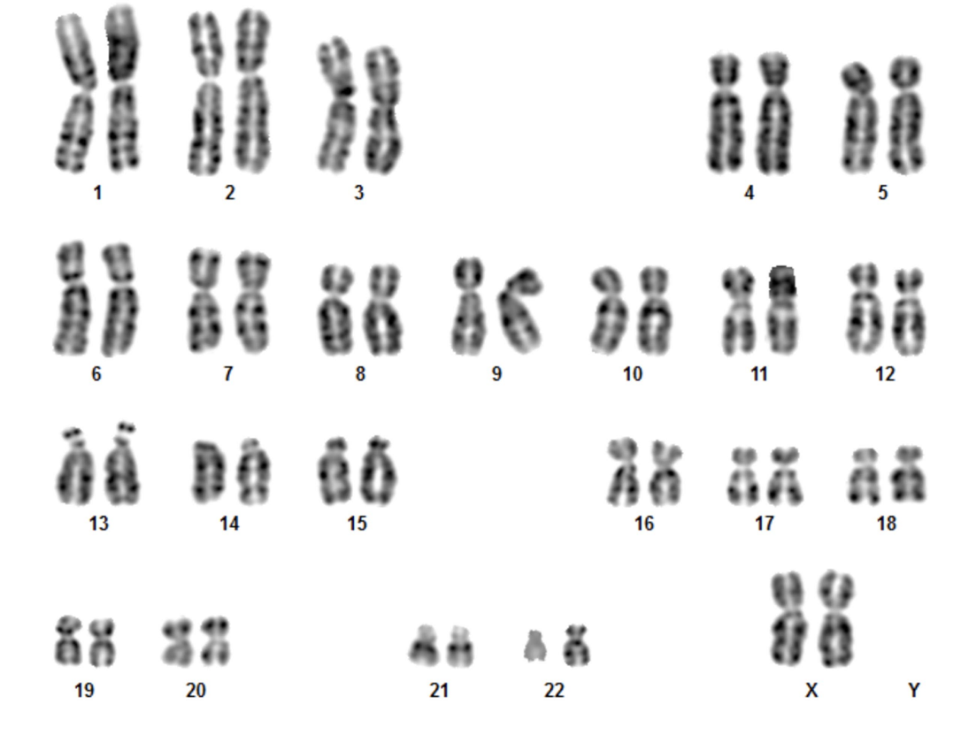
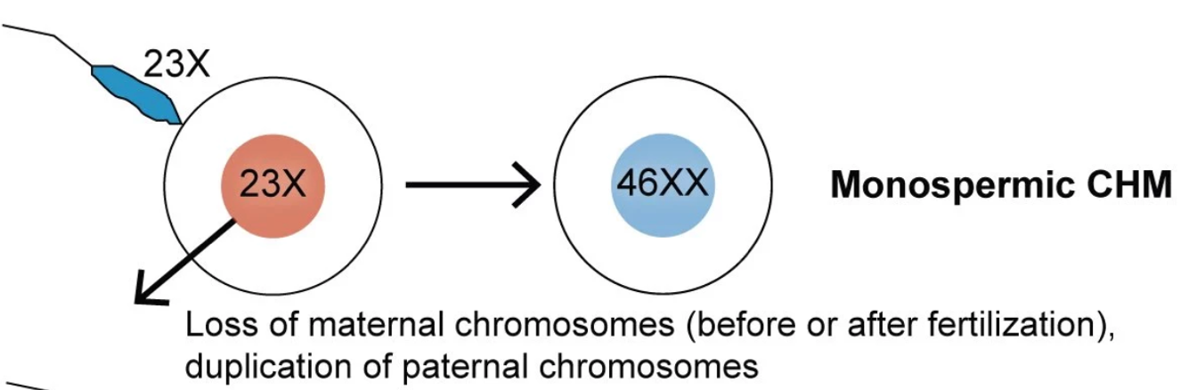
The human (reference) genome: T2T (CHM13)
T2T = CHM13hTERT cell line
CHM = Complete Hydatidiform Mole
Uniformly homozygous for one set
of alleles (effectively haploid)
T2T = actual genome
46,XX karyotype
Miga et al., Nature, 2020

Slide 22
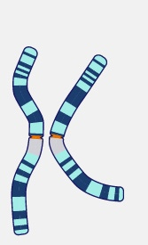



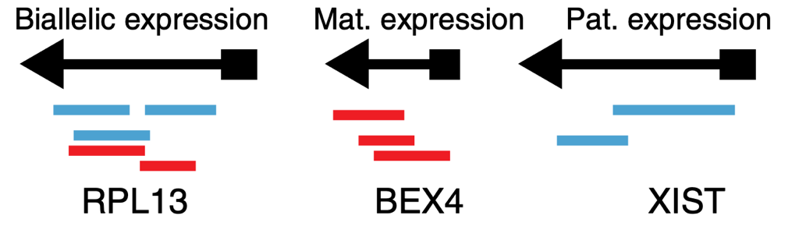
The human (diploid) genome
maternal + paternal haplotypes
= diploid genome
cis-acting genetic variants + genomic imprinting
= unequal and allele-specific expression
Vertesy et al., 2018

Slide 23
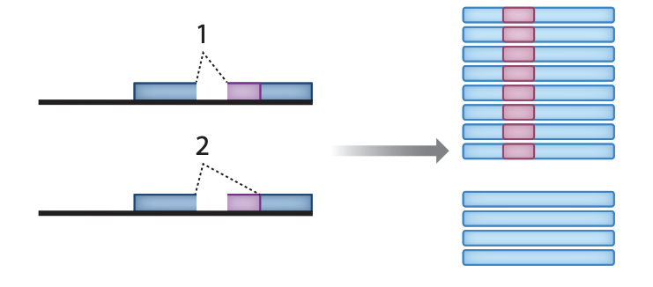
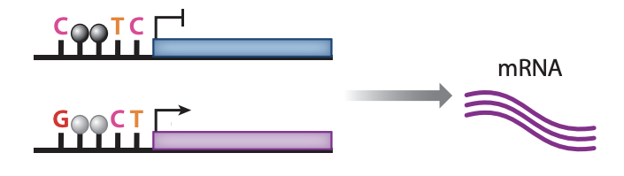
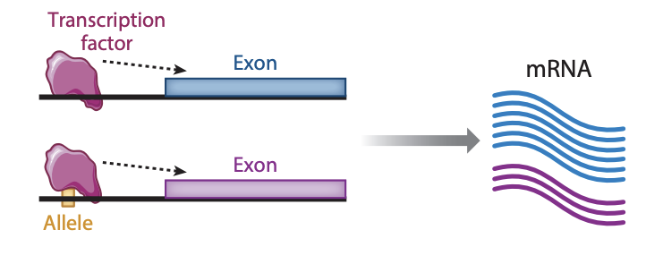
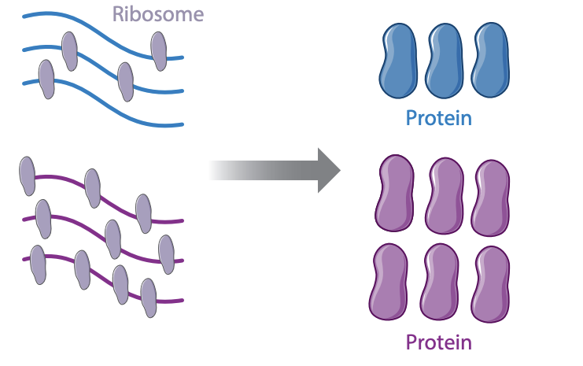
Mechanisms of allelic imbalance
DNA methylation
splicing
enhancer function
translation
Cleary & Seoighe, 2021

Slide 24
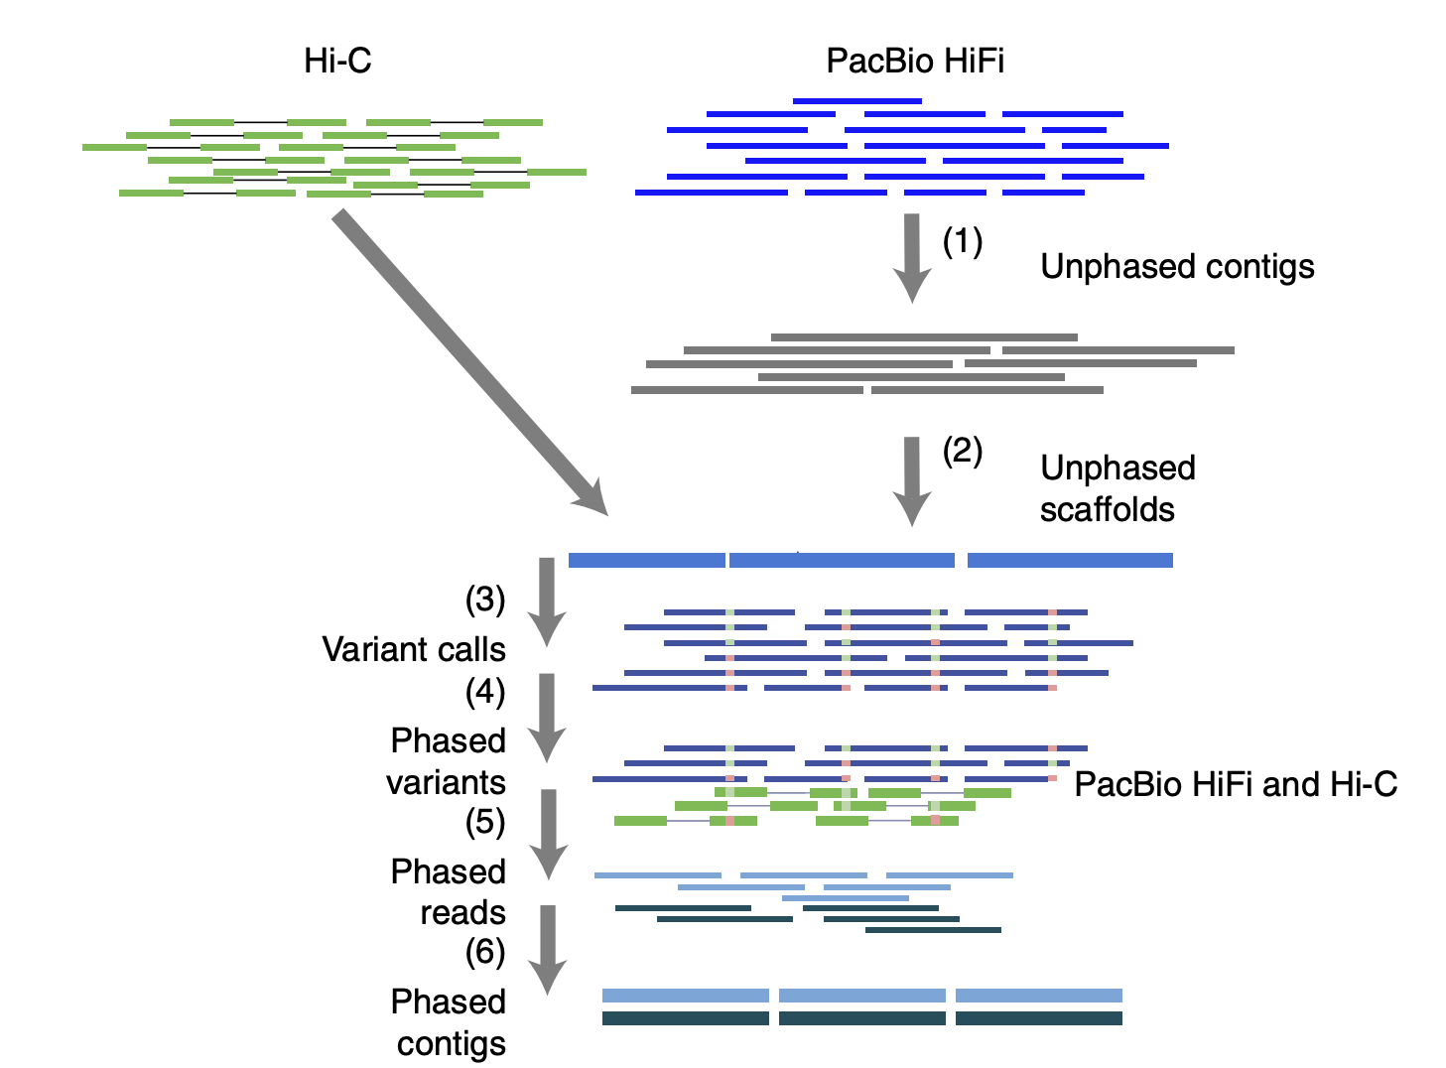
Phased genome assembly
Haplotype-resolved assemblies using long read sequencing and long-range conformation (Hi-C) data
Garg et al., Nature Biotech. 2021

Slide 25
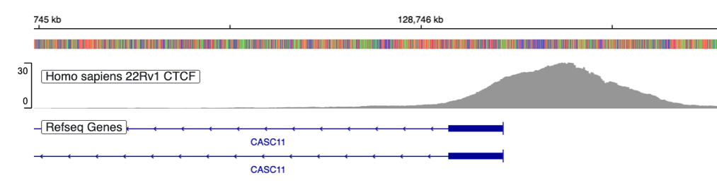
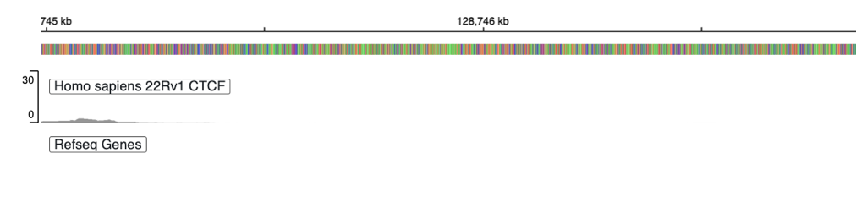
The challenge with multiple references
hg19 coordinates are different than hg38 coordinates
hg19
hg38
chr8:128,745,000–128,746,800
chr8:128,745,000–128,746,800
Which reference did Smith et al. use in their genomic analyses?
~14 years of genomic alignment + analyses with hg19
Genome coordinates must be converted for data integration
(https://genome.ucsc.edu/cgi-bin/hgLiftOver)

Slide 26
Questions?

Slide 27

Introduction to Linux / Biocluster

Slide 28
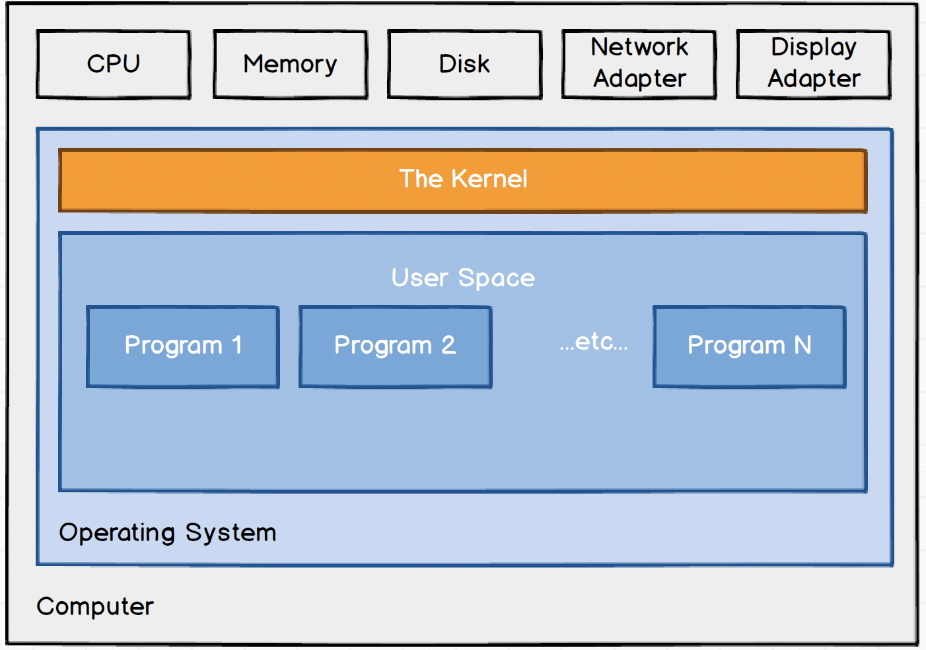
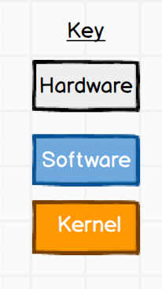
Introduction to Linux / Biocluster
Linux/Unix = multi-user and multi-processing operating system
Efficient, fast, stable, secure
multi-user operating system
Process numerous files at once
Execute computationally
intensive software
Powerful command-line tools
user – operating system interface
Dave Kerr
dwmkerr.com

Slide 29


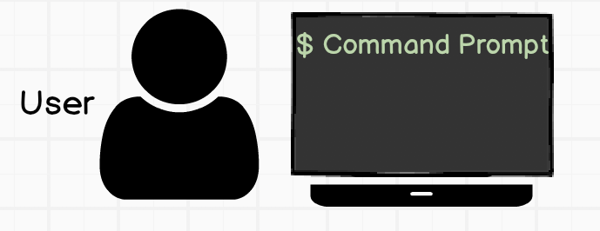
Introduction to Linux / Biocluster
Linux/Unix = multi-user and multi-processing operating system
Terminal (CLI) passes user
input to shell and displays
results
Dave Kerr
dwmkerr.com

Slide 30
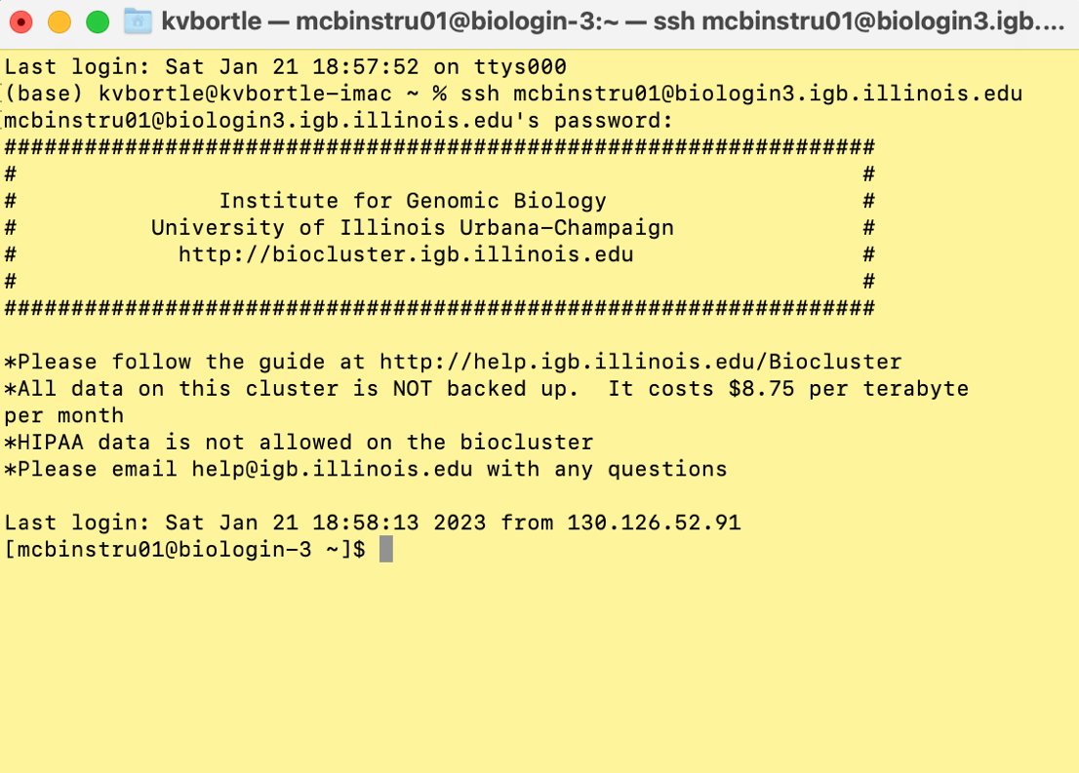
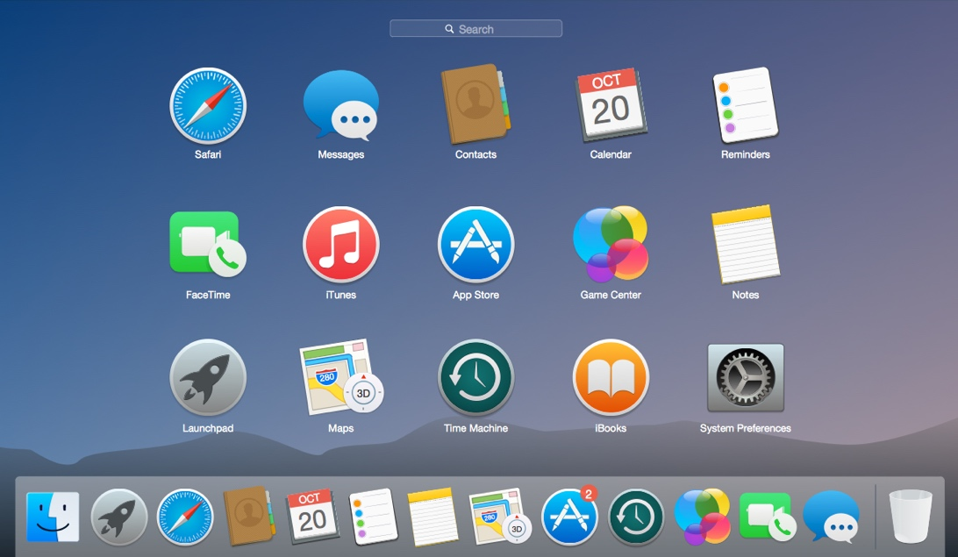
User interface – communicate with operating system
Command line interface (CLI)
Graphic user interface (GUI)
command prompt
point-and-click, command shortcuts,
graphical representation of files, etc.

Slide 31
Introduction to Linux / Biocluster
Linux/Unix = multi-user and multi-processing operating system
Shell (interpreter): sh, bash, zsh..
issues command prompt at login
when used interactively
passes command line to kernel
for execution
returns prompt after execution
(error display if not executable)
Dave Kerr
dwmkerr.com

Slide 32
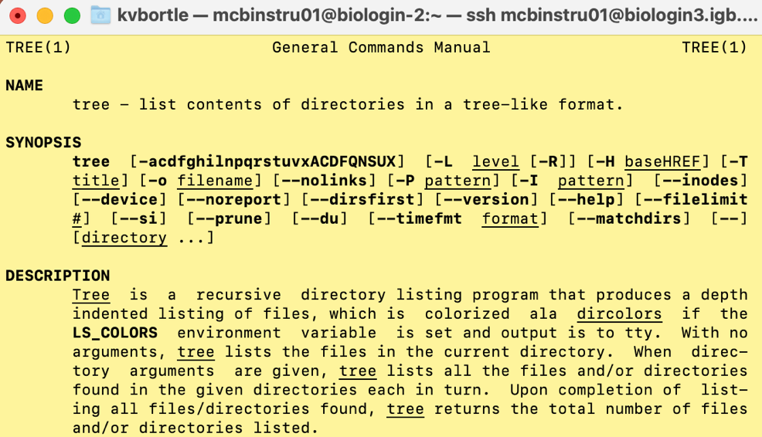
Introduction to Linux / Biocluster
Linux/Unix = multi-user and multi-processing operating system
tree = simple program
Dave Kerr
dwmkerr.com

Slide 33
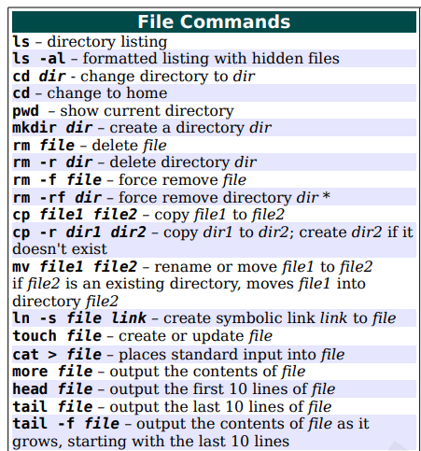
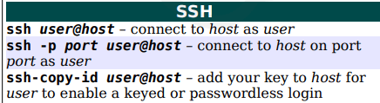

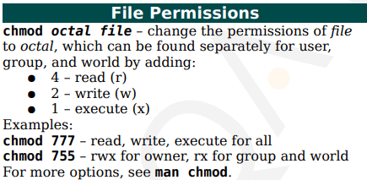
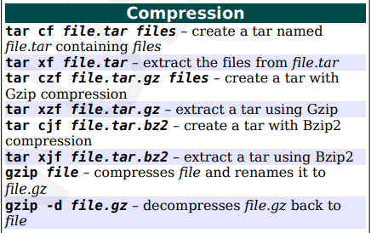
Linux/Unix commands list
ssh = secure shell
remote network tool
login to remote machine (biocluster), execute commands

Slide 34

Launching terminal (MacOS)
ssh classID@biologin3.igb.Illinois.edu
** use your class ID provided in Slack
and enter password when prompted

Slide 35
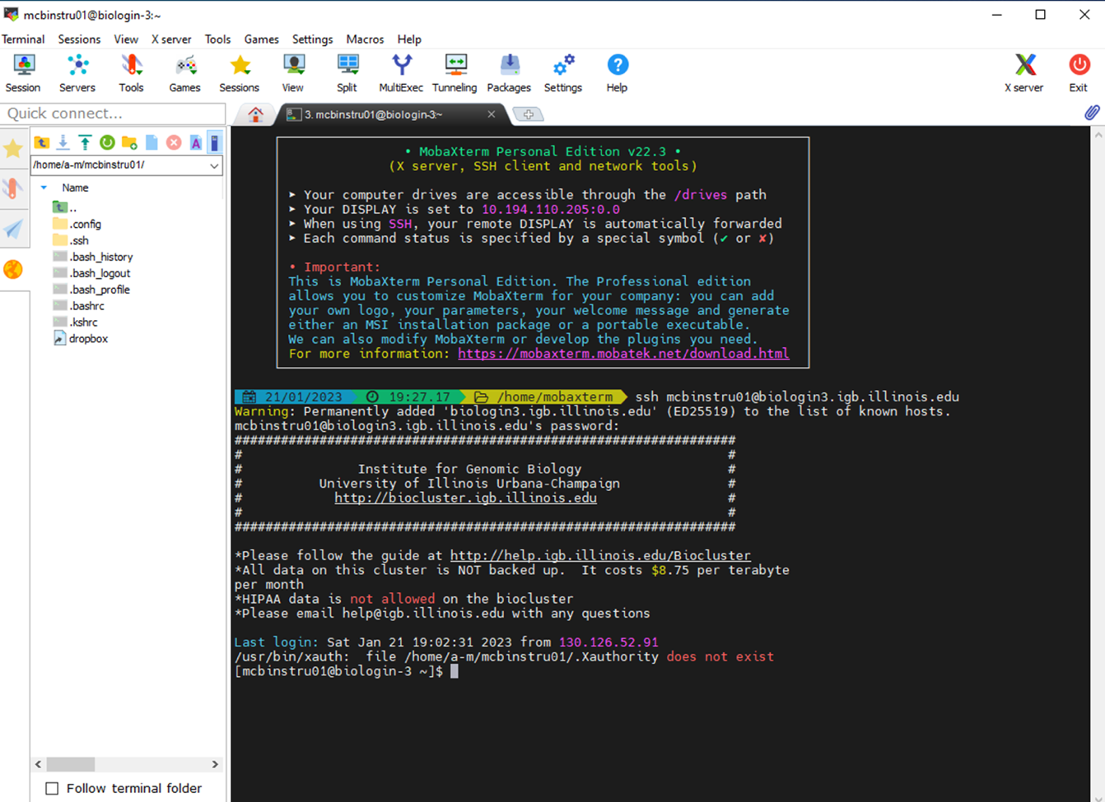
Launching MobaXterm (Windows)
ssh classID@biologin3.igb.Illinois.edu
** use your class ID provided in Slack
and enter password when prompted

Slide 36
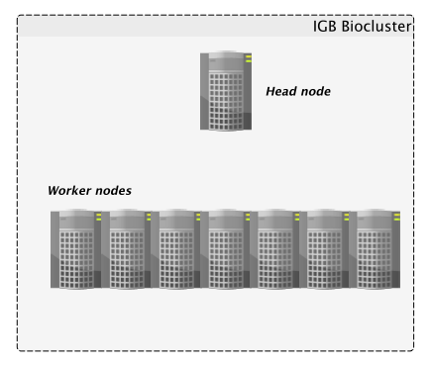


IGB Biocluster
Biocluster = HPC cluster (collection of many computers, called nodes)
Initial login puts us on the login node
*do not execute memory intensive programs on login node!*
Login nodes are connected to internet
Used for scheduler-related tasks (job submission) or commands requiring internet access (e.g. wget, scp, rsync)
otherwise, login to computer node …
Login node
Chris Fields

Slide 37
IGB Biocluster
Biocluster = HPC cluster (collection of many computers, called nodes)
Head node gives instructions to worker computer nodes
SLURM
(Simple Linux Utility for Resource Management)
Program that schedules job submissions
e.g. sbatch, srun, squeue
Login node
Chris Fields

Slide 38
IGB Biocluster
Biocluster = HPC cluster (collection of many computers, called nodes)
Worker (compute) nodes
temporary computing resources
standard batch job
e.g. sbatch myscript.sh
interactive batch mode
e.g. srun -p classroom --pty bash
Login node
Chris Fields

Slide 39
IGB Biocluster
Biocluster = HPC cluster (collection of many computers, called nodes)
Worker (compute) nodes
temporary computing resources
standard batch job
e.g. sbatch myscript.sh
interactive batch mode
e.g. srun -p classroom --pty bash
Login node
Chris Fields

Slide 40
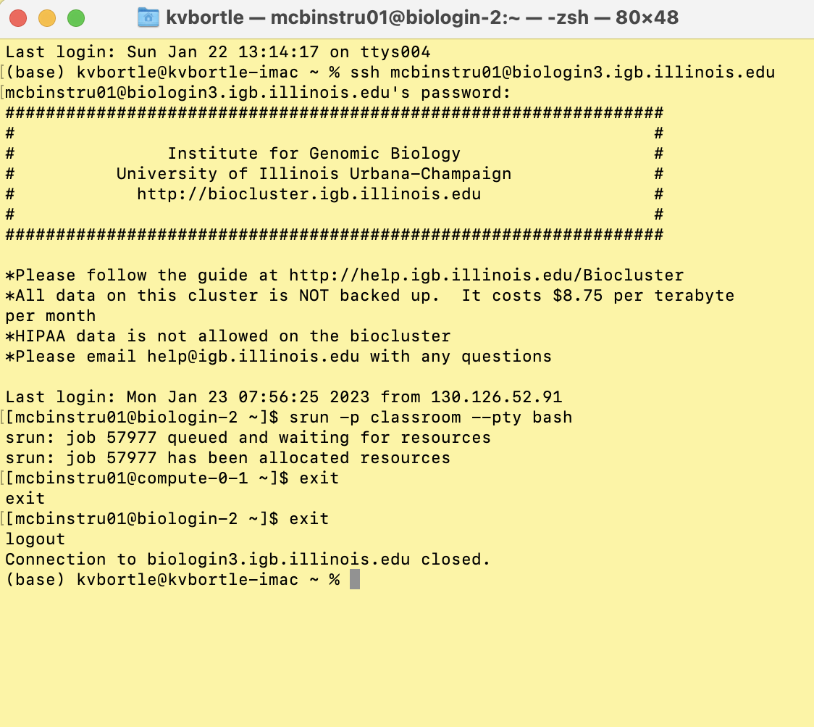
Interactive batch mode
Login node (biologin-2)
srun -p classroom --pty bash
Compute node (compute-0-1)
Exit command to disconnect
(both compute note and login node)

Slide 41
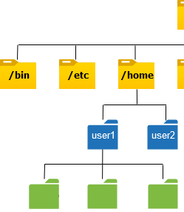

Linux directory structure
Think of the filesystem as a hierarchical tree structure
Root directory “/” base of filesystem hierarchy
contains everyone’s home directories
LinuxYogi
linuxyogi.com
your directory (e.g. mcb99)
your subdirectories and files

Slide 42
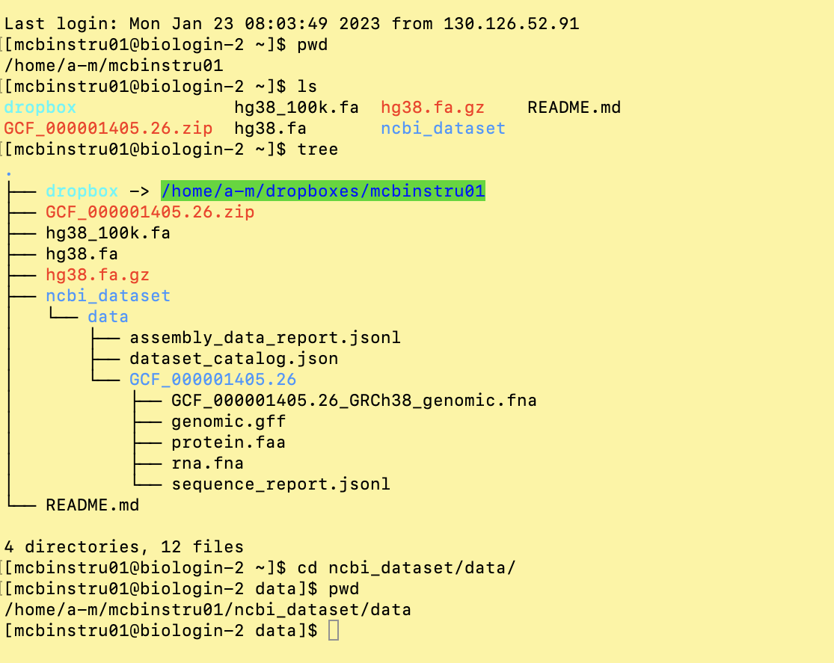
Navigating the directory (tree) structure
pwd = print working directory
ls = list files and directories
tree = recursively list directory content in tree
cd = change directory

Slide 43
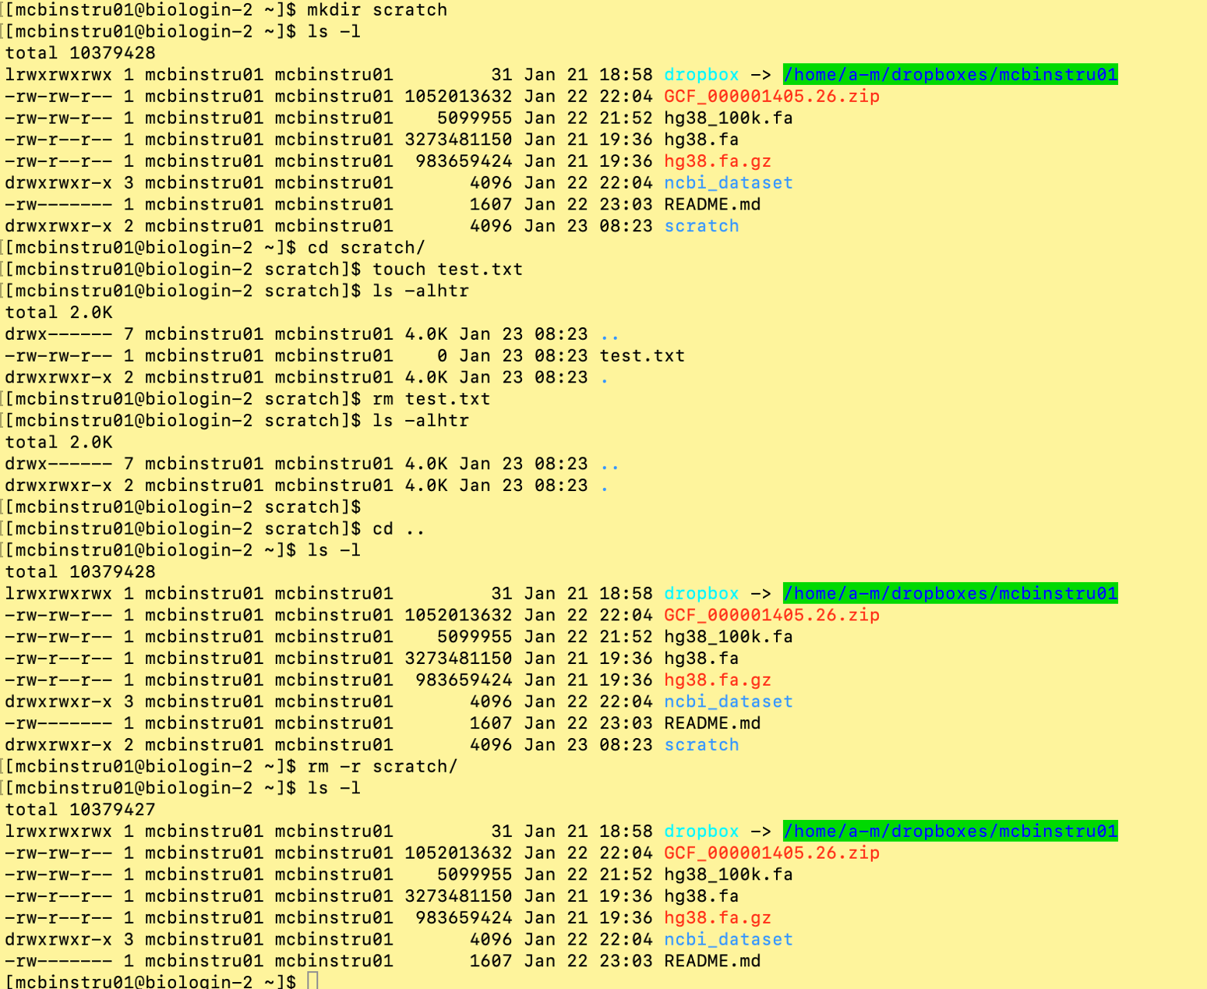
Working with files and directories
mkdir = make directory
touch = create new empty file
rm = remove (delete) file
cd .. = navigate up one directory level
rm –r = remove (delete) directory

Slide 44
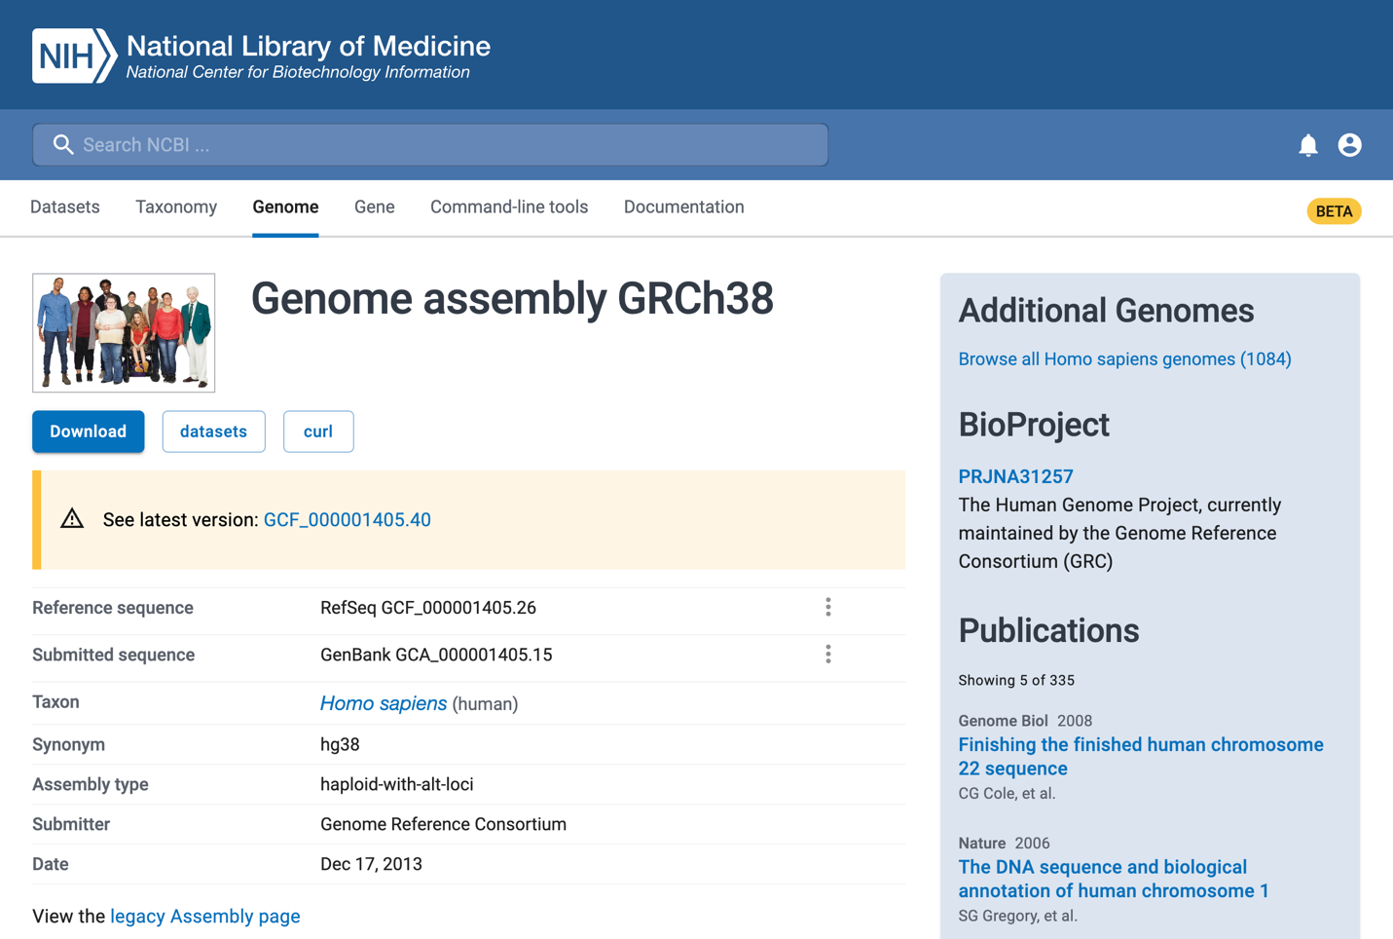
NCBI / GenBank
We want to use GRCh38 as our reference for genomic analyses:

Slide 45
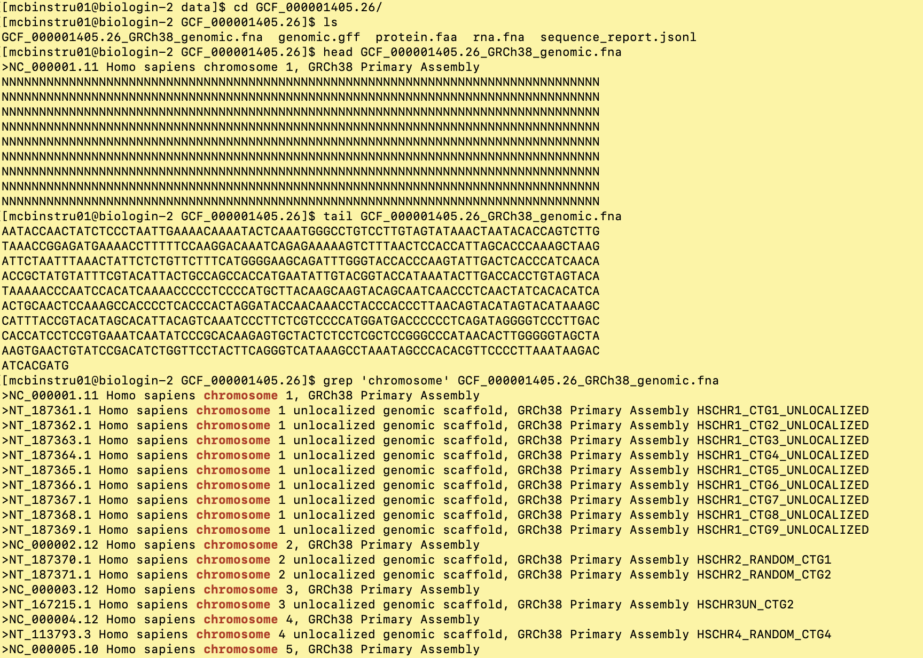
Examining files
head = output first 10 lines of file
tail = output last 10 lines of file
grep = search and return a
specific pattern of
characters

